Slide 1

HOTEL RESERVATION ANALYSIS WITH SQL
Data Analyst Internship from Mentorness
-Aman Singh
Batch Name: MIP-DA-10

Slide 2

OVERVIEW
In this Project, you will use SQL to answer the questions related to dataset. This will help you to develop
your data analysis skills in a practical context.
The hotel industry relies on data to make informed decisions and provide a better guest experience.
In this internship, I will work with a hotel reservation dataset to gain insights into guest preferences, booking trends, and other key factors that impact the hotel's operations.
I use SQL to query and analyze the data, as well as answer specific questions about the dataset.

Slide 3

DATASET DETAILS:
•Booking_ID: A unique identifier for each hotel reservation.
•no_of_adults: The number of adults in the reservation.
no_of_children: The number of children in the reservation.
no_of_weekend_nights: The number of nights in the reservation that fall on weekends.
no_of_week_nights: The number of nights in the reservation that fall on weekdays.
type_of_meal_plan: The meal plan chosen by the guests.
room_type_reserved: The type of room reserved by the guests.
lead_time: The number of days between booking and arrival.
arrival_date: The date of arrival.
market_segment_type: The market segment to which the reservation belongs.
avg_price_per_room: The average price per room in the reservation.
booking_status: The status of the booking.

Slide 4
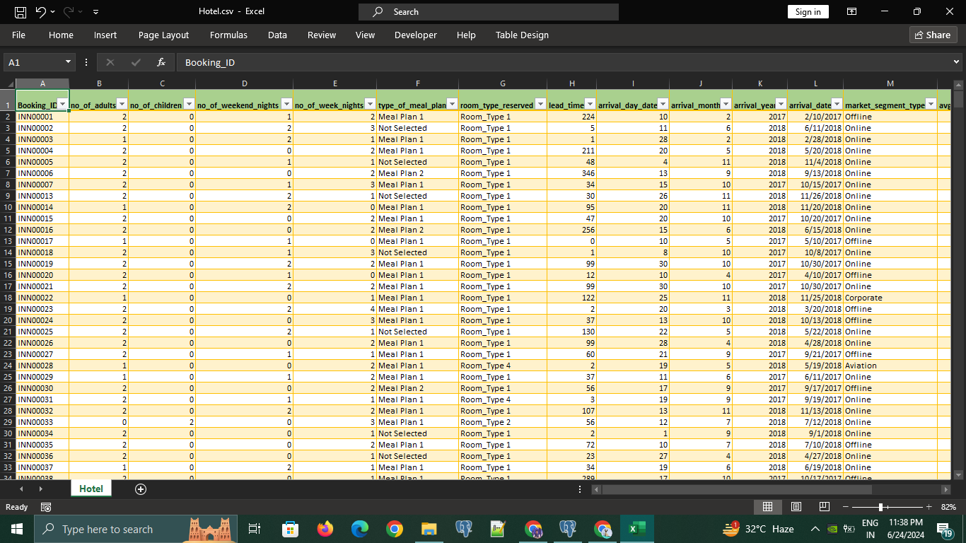
DATASET PREVIEW:

Slide 5


DATA ANALYSIS TIME
~ SQL QUERY TIME

Slide 6


Q1. WHAT IS THE TOTAL NUMBER OF RESERVATIONS IN THE DATASET?
Query:-
select count(*) as total_no_of_reservations from "Hotel"
Result:-

Slide 7
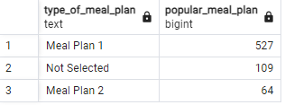
Q2. WHICH MEAL PLAN IS THE MOST POPULAR AMONG GUESTS?
Query:-
select type_of_meal_plan,count(type_of_meal_plan) as popular_meal_plan from "Hotel"
group by type_of_meal_plan
order by count(type_of_meal_plan) desc
Result:-

Slide 8

Q3. WHAT IS THE AVERAGE PRICE PER ROOM FOR RESERVATIONS INVOLVING CHILDREN?
Query:-
select avg(avg_price_per_room) from "Hotel"
where no_of_children >0
Result:-

Slide 9

Q4. HOW MANY RESERVATIONS WERE MADE FOR THE YEAR 20XX (REPLACE XX WITH THE DESIRED YEAR)?
Query:-
select count("Booking_ID") as resv_on_YEAR_2018 from "Hotel"
where arrival_year = 2018
Result:-

Slide 10
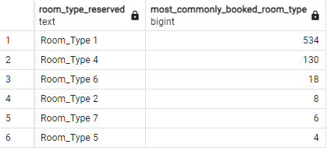
Q5. WHAT IS THE MOST COMMONLY BOOKED ROOM TYPE?
SELECT ROOM_TYPE_RESERVED,COUNT(ROOM_TYPE_RESERVED) as most_commonly_booked_room_type FROM "Hotel"
group by ROOM_TYPE_RESERVED
order by COUNT(ROOM_TYPE_RESERVED) desc
Query:-
Result:-

Slide 11

Q6. HOW MANY RESERVATIONS FALL ON A WEEKEND (NO_OF_WEEKEND_NIGHTS>0)?
Query:-
select count(no_of_weekend_nights) as total_resv_on_weekend from "Hotel"
where no_of_weekend_nights >0
Result:-

Slide 12

Q7. WHAT IS THE HIGHEST AND LOWEST LEAD TIME FOR RESERVATIONS?
Query:-
select max(lead_time) as maximum_lead_time, min(lead_time) as min_lead_time from "Hotel"
Result:-

Slide 13
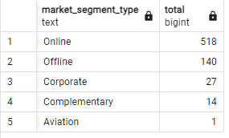
Q8. WHAT IS THE MOST COMMON MARKET SEGMENT TYPE FOR RESERVATIONS?
select market_segment_type, count(market_segment_type) as total from "Hotel"
group by market_segment_type
order by count(market_segment_type) desc
Query:-
Result:-

Slide 14

Q9. HOW MANY RESERVATIONS HAVE A BOOKING STATUS OF "CONFIRMED"?
Query:-
select count(booking_status) as no_of_confirmed_booking from "Hotel"
where booking_status = 'Not_Canceled'
Result:-

Slide 15

Q10. WHAT IS THE TOTAL NUMBER OF ADULTS AND CHILDREN ACROSS ALL RESERVATIONS?
select sum(no_of_adults) as total_adults , sum(no_of_children) as total_children from "Hotel"
Query:-
Result:-

Slide 16

Q11. WHAT IS THE AVERAGE NUMBER OF WEEKEND NIGHTS FOR RESERVATIONS INVOLVING CHILDREN?
Query:-
select avg(no_of_weekend_nights) as average_week_child from "Hotel"
where no_of_children >0
Result:-

Slide 17
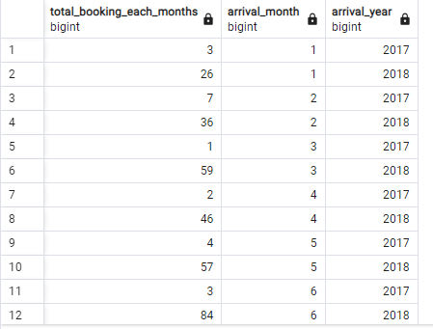
Q12. HOW MANY RESERVATIONS WERE MADE IN EACH MONTH OF THE YEAR?
Result:-
Query:-
select count("Booking_ID") as total_bokking_each_months, arrival_month, arrival_year from "Hotel"
group by arrival_month, arrival_year
order by arrival_month,arrival_year

Slide 18
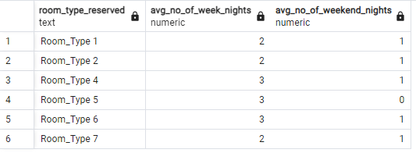
Q13. WHAT IS THE AVERAGE NUMBER OF NIGHTS (BOTH WEEKEND AND WEEKDAY) SPENT BY GUESTS FOR EACH ROOM TYPE?
Query:-
select room_type_reserved,round(avg(no_of_week_nights),0) as avg_no_of_week_nights ,round(avg(no_of_weekend_nights),0) as avg_no_of_weekend_nights from "Hotel"
group by room_type_reserved
order by room_type_reserved
Result:-

Slide 19
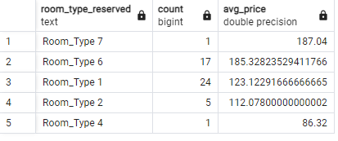
Q14. FOR RESERVATIONS INVOLVING CHILDREN, WHAT IS THE MOST COMMON ROOM TYPE, AND WHAT IS THE AVERAGEPRICE FOR THAT ROOM TYPE?
Query:-
select room_type_reserved , count(room_type_reserved),avg(avg_price_per_room) as avg_price from "Hotel"
where no_of_children >0
group by room_type_reserved
order by avg(avg_price_per_room) desc
Result:-

Slide 20
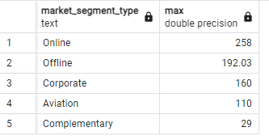
Q15. FIND THE MARKET SEGMENT TYPE THAT GENERATES THE HIGHEST AVERAGE PRICE PER ROOM ?
select market_segment_type , max(avg_price_per_room) from "Hotel"
group by market_segment_type
order by max(avg_price_per_room) desc
Query:-
Result:-

Slide 21
Overall Insights
Our dataset have total 700 Bookings.
Meal Plan 1 is the TOP pick among all guest.
Booking that includes kids/ children have a mean room cost of 144.6.
Total no. of reservations in 2018 is 577.
Among all room types Room Type 1 is the most frequent booked.
Out of 700 bookings, 493 are confirmed , yielding a success rate of approx. 70.45 %.
Majority of Bookings made by adults (approx. 1,316).
October is most Busiest month for booking, while January has the fewest.
Online segment is the most frequent used foe bookings.
Immediate bookings (arrivals on the same day) are predominantly made by guests from online, corporates and offline segment.
For bookings that includes kids, Room Type 1 (more spacious) is the top choice , with the average room cost of 123.12.

Slide 22
T
H
A
N
K
Y
O
U

